Slide 1
Cleveland Clinic Preliminary Feature Selection

Slide 2
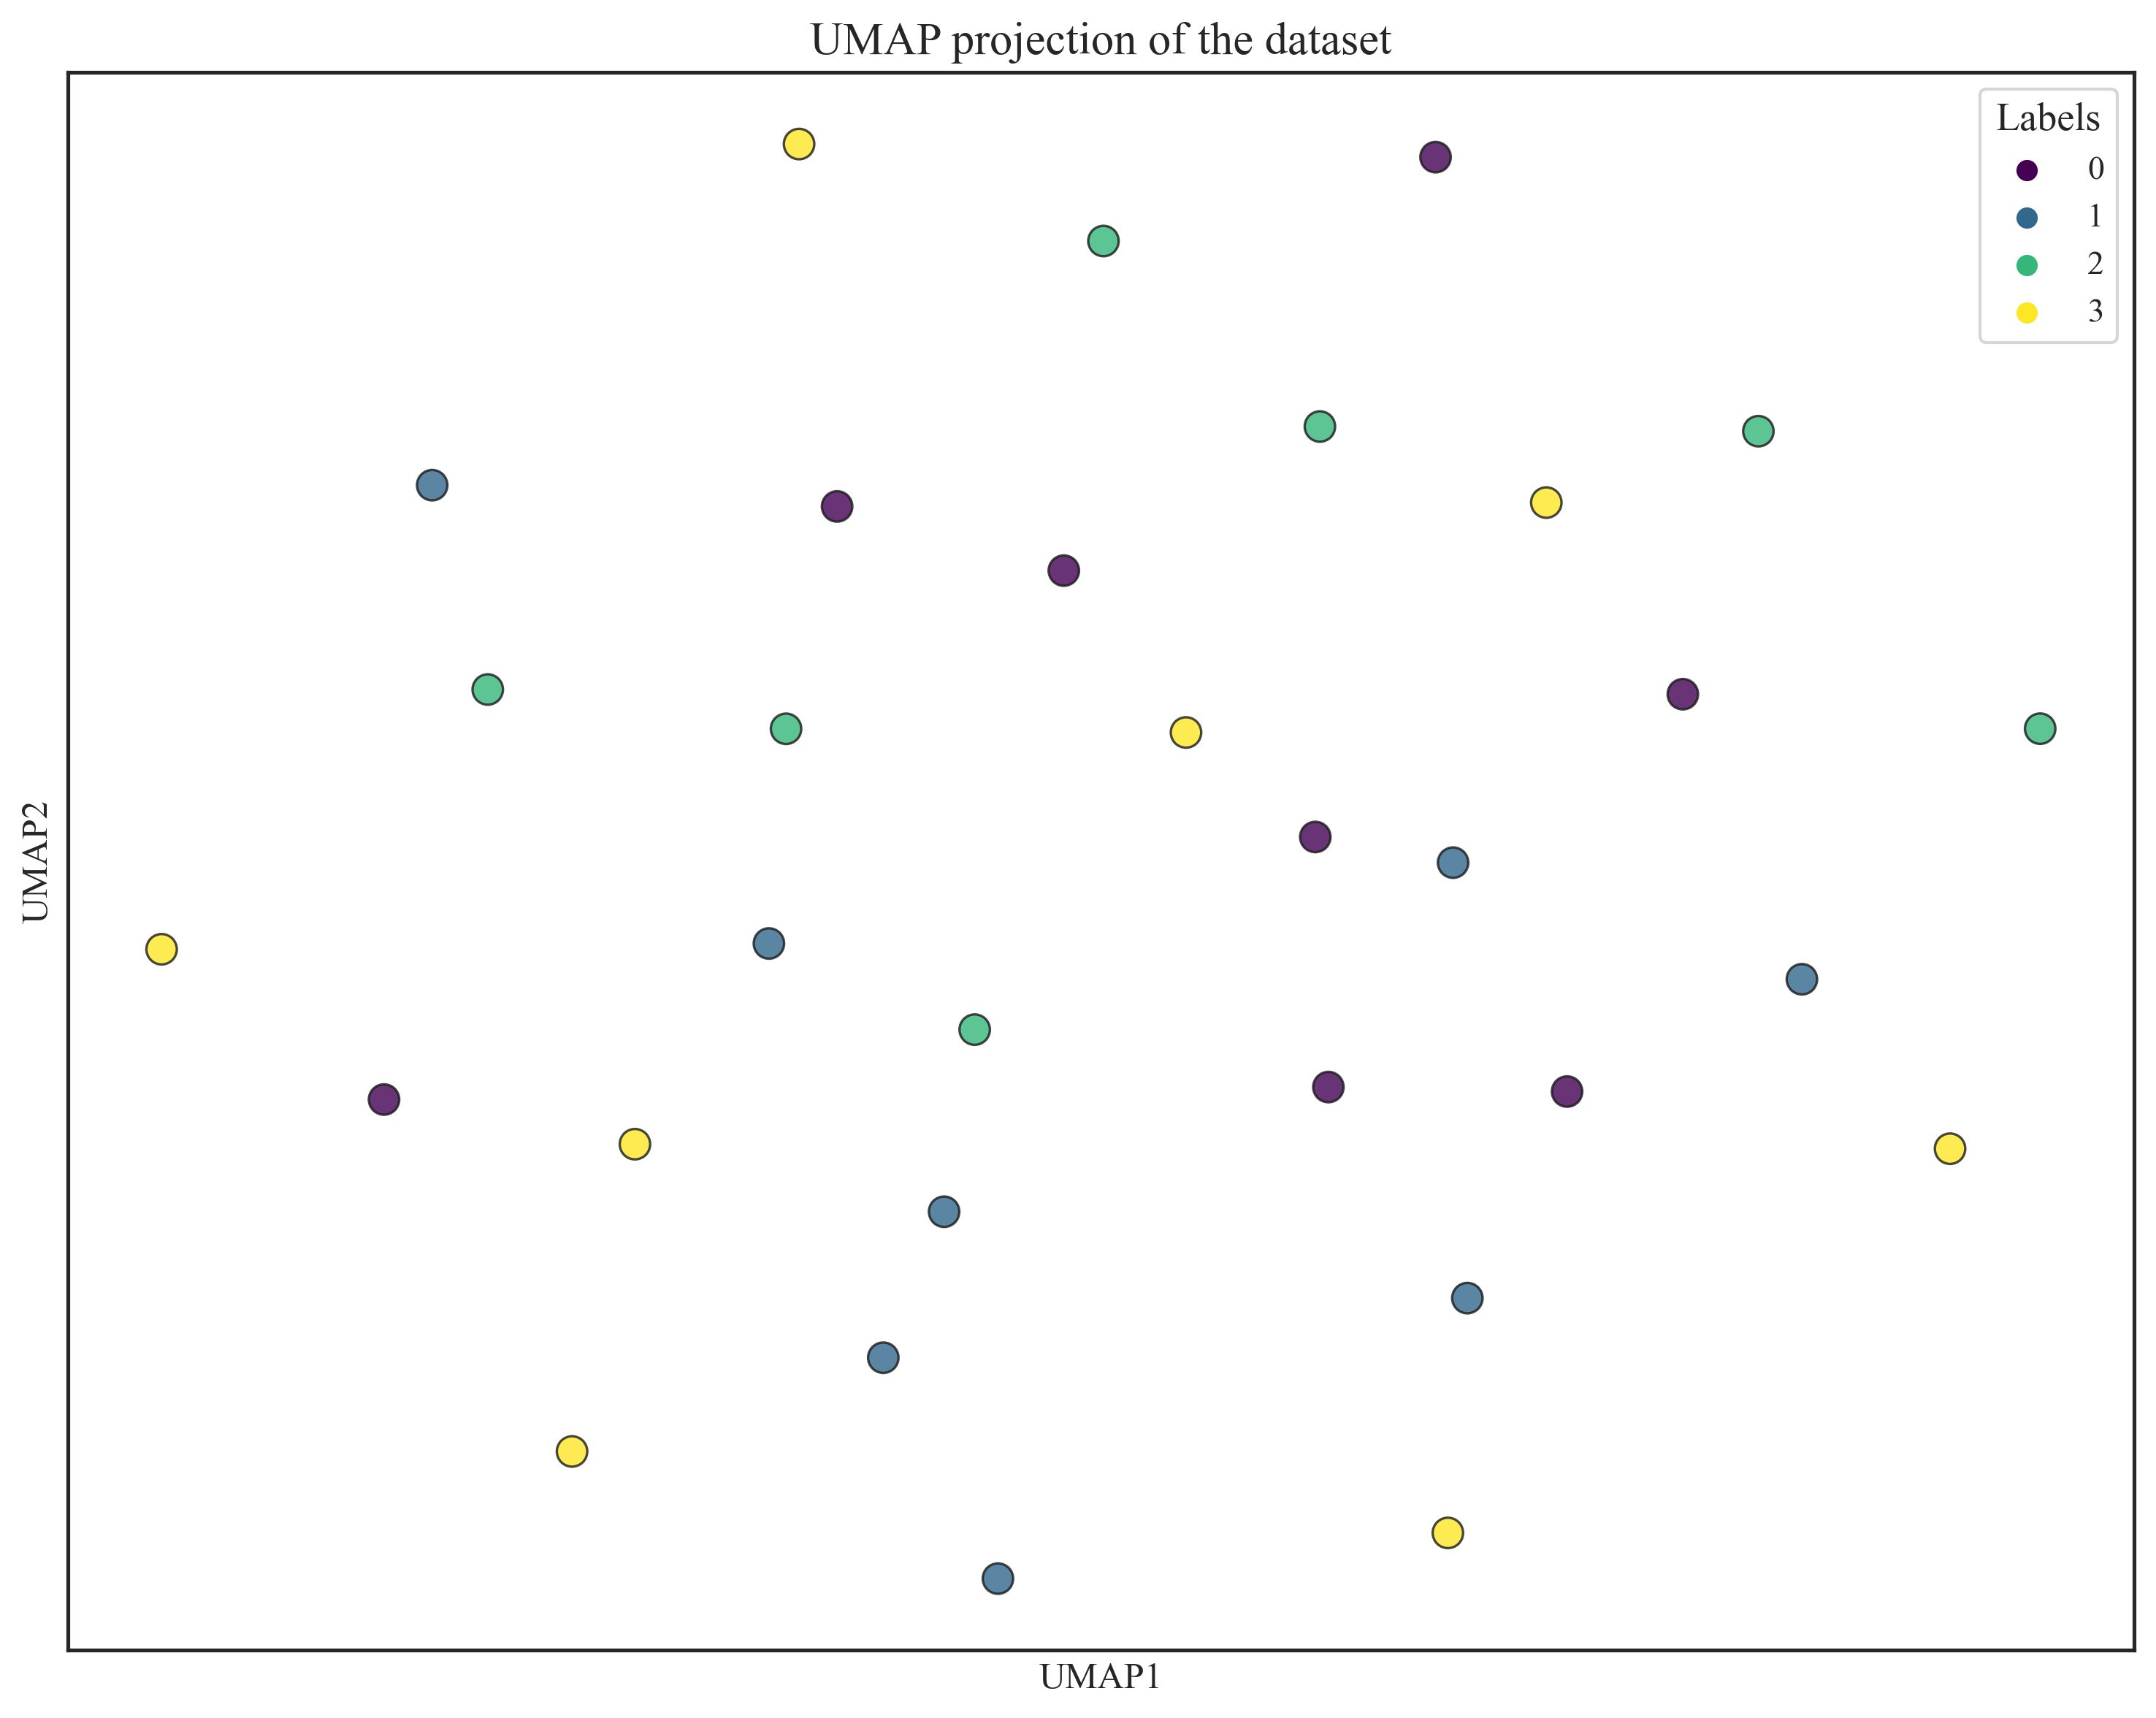
UMAP (no feature selection)
Label 0: Non-Exercise PBS
Label 1: Non-Exercise AmAc
Label 2: Exercise PBS
Label 3: Exercise AmAc

Slide 3
Removed DEGs
'Cd209f'
'Cd209g'
'Fcgbp'
'2310016D03Rik'
'2310020H05Rik'
'2310030G06Rik'
'2310069B03Rik'
'5430401H09Rik'
'9430073C21Rik'
'A730036I17Rik'
'Abhd18'
'Actn2'
'Adprhl1'
'Aldh1b1'
'Aldoa-ps4'
'Alox12'
'Ampd3'
'Ankrd1'
'Arpp21'
'Atp1b1'
'Casq2'
'Cdh22'
'Coq8a'
'Cryab'
'Dct'
'Dnaja4'
'E2f8'
'Egln3'
'Enah'
'Fabp3'
'Fgf1'
'Fgf10'
'Fhl1'
'Fndc5'
'Fxyd6'
'Fzd10'
'Glb1l2'
'Gm11716'
'Gm32391'
'Gm41757'
'Gm45012'
'Gm49083'
'Grb14'
'Homer2'
'Hspb7'
'Idh2'
'Ifrd1'
'Inpp4b'
'Inpp5j'
'Kcnn3'
'Khdrbs3'
'Lamc2'
'Lmcd1'
'Lmod2'
'Lpl'
'Lrrn1'
'Mb'
'mt-Tw'
'Myh1'
'Myh13'
'Myh2'
'Myh3'
'Myo5b'
'Nlrc3'
'Nrtn'
'Pdlim1'
'Pla2g2d'
'Ppara'
'Prkg1'
'Scube2'
'Slc9a4'
'Smtnl1'
'Sox9'
'Spinkl'
'Srxn1'
'Sult1e1'
'Tecrl'
'Tiam2'
'Tlr4'
'Tnfrsf12a'
'Togaram2'
'Ttc9'
'Xirp1'
'Xpo4'
'Zfp385b'
'Zfp697'

Slide 4
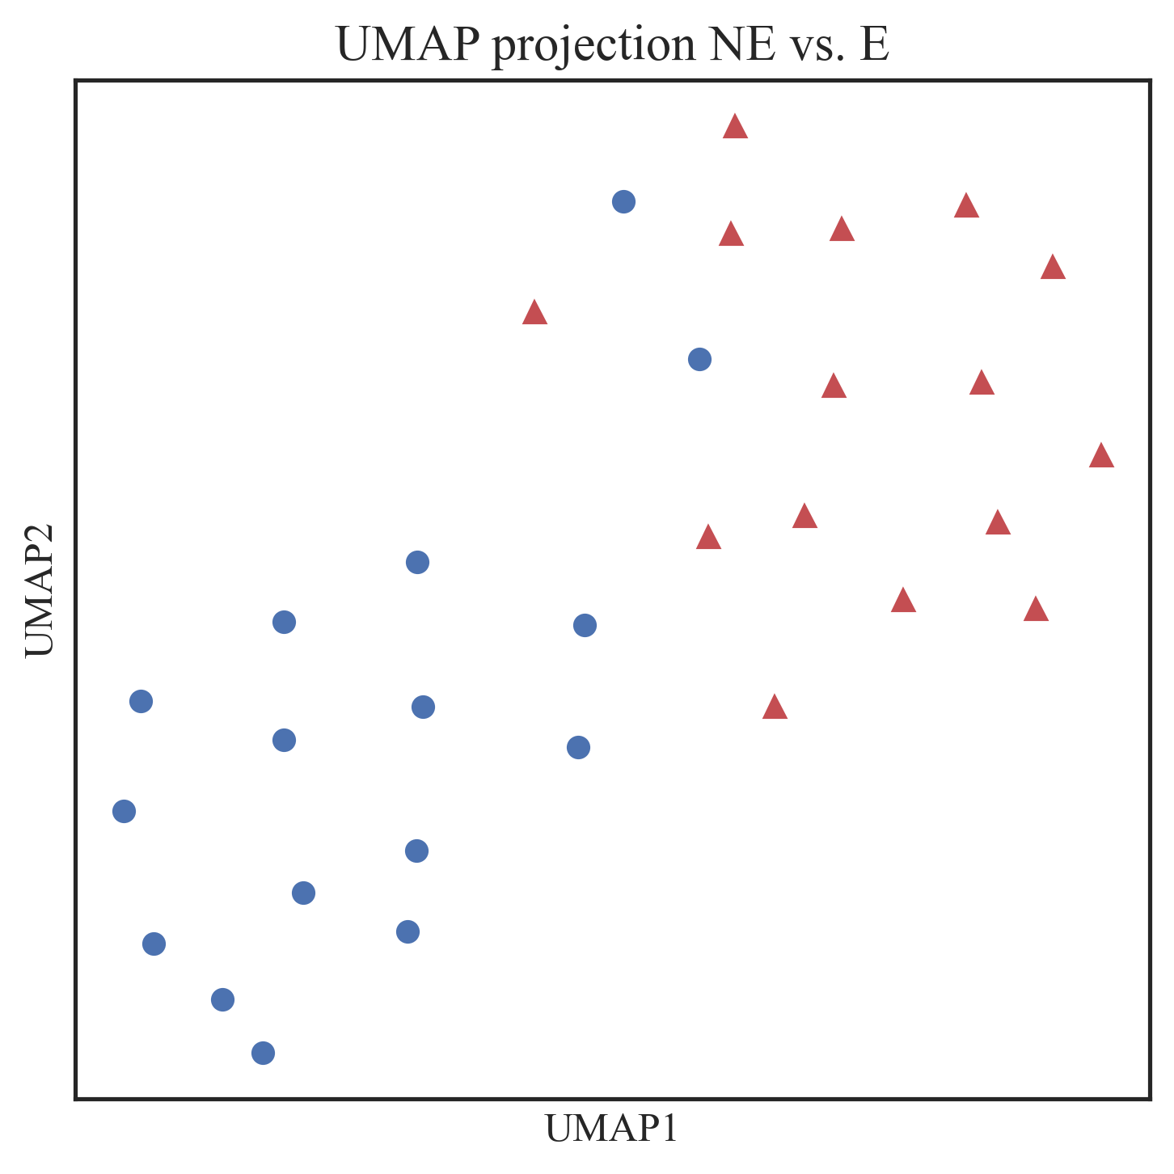
Relief-F (K=3)
Top 10 features
NE vs. E
'ENSMUSG00000113427': 'Gm46378',
'ENSMUSG00000024399': 'Ltb',
'ENSMUSG00000115539': 'Gm6997',
'ENSMUSG00000113789': 'Gm47322',
'ENSMUSG00000073482': 'Gm10517',
'ENSMUSG00000040592': 'Cd79b',
'ENSMUSG00000081768': 'Gm12755',
'ENSMUSG00000111155': 'Gm47197',
'ENSMUSG00000087142': 'Gm12454',
'ENSMUSG00000115737': 'Rpl19-ps3'

Slide 5
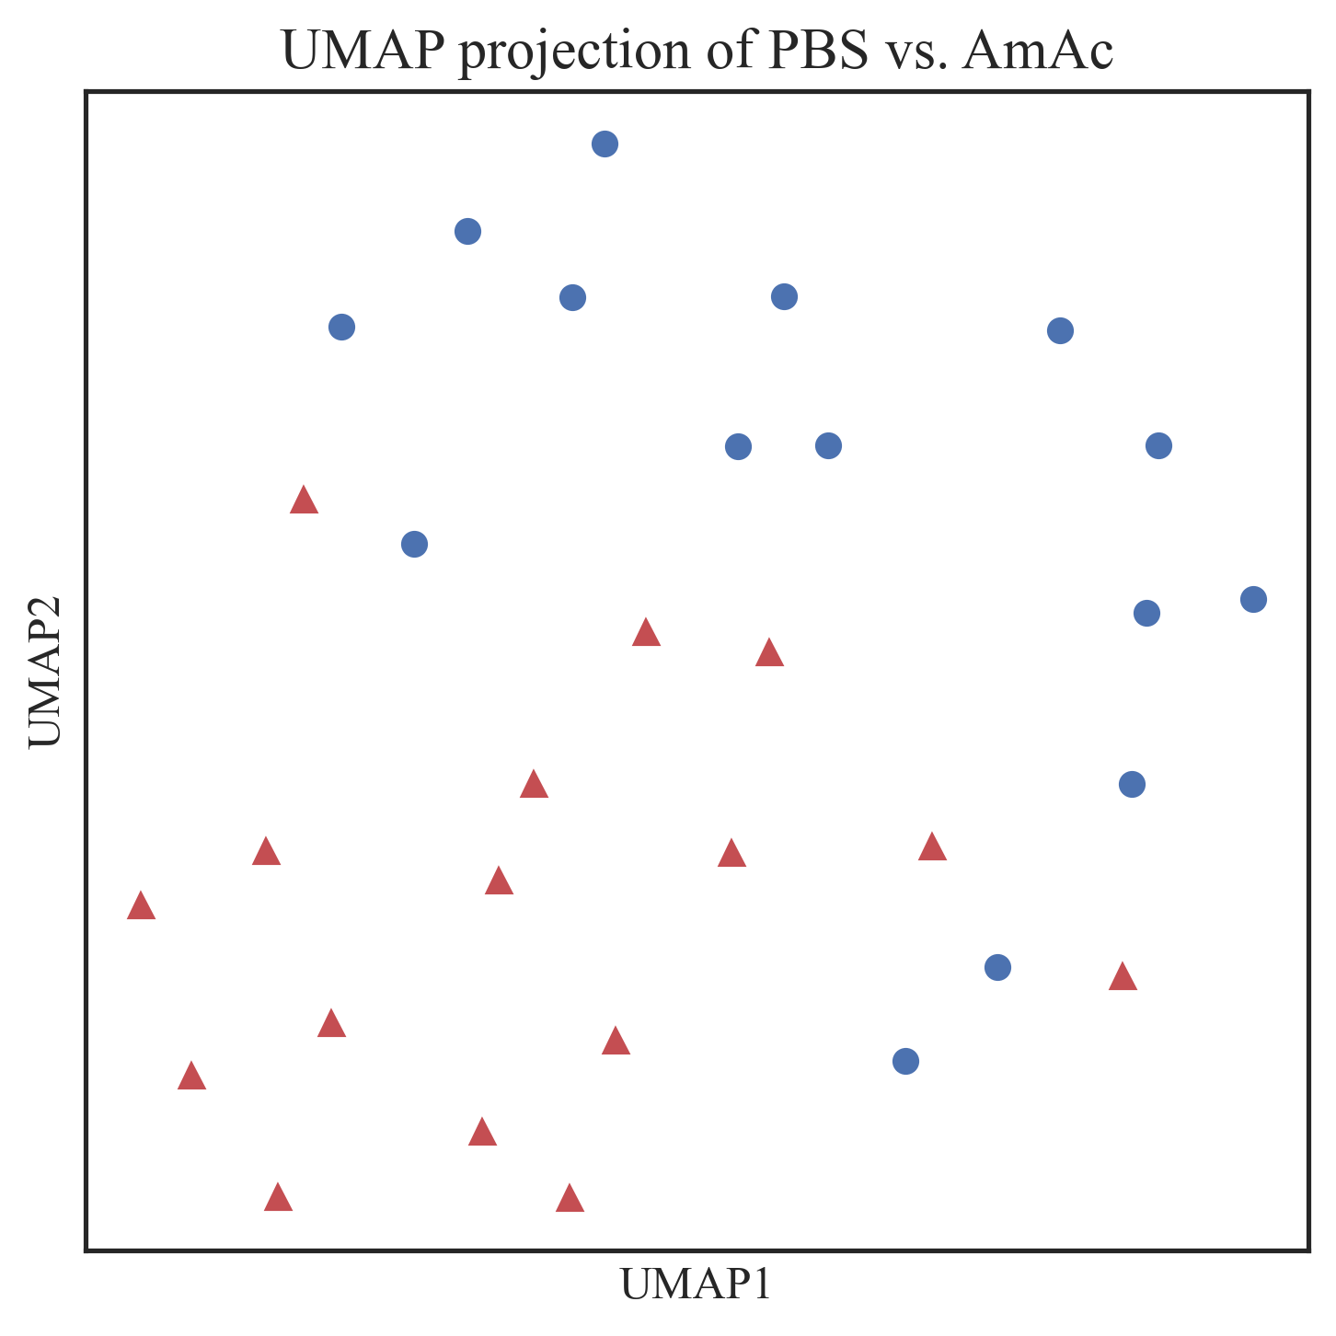
Relief-F (K=3)
Top 10 features
PBS vs. AmAc
'ENSMUSG00000093682': 'Gm20681',
'ENSMUSG00000081492': 'Gm9311',
'ENSMUSG00000085699': 'Gm14298',
'ENSMUSG00000086489': 'Gm16362',
'ENSMUSG00000038071': 'Npy6r',
'ENSMUSG00000097336': 'Fendrr',
'ENSMUSG00000085288': 'Gm16356',
'ENSMUSG00000109697': 'Gm34030',
'ENSMUSG00000085366': 'Gm16358',
'ENSMUSG00000118320': 'Gm50425'

Slide 6
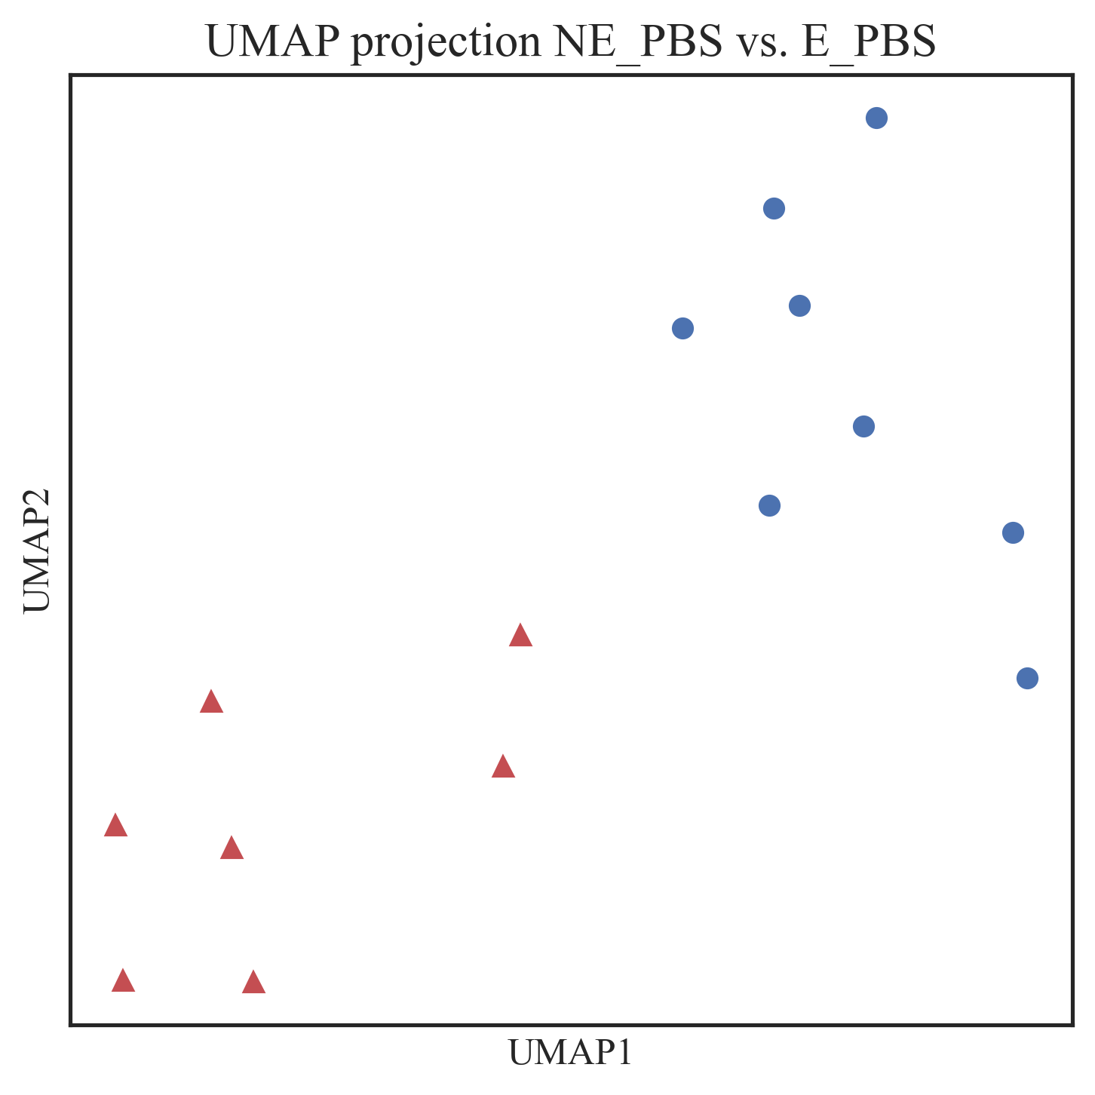
Relief-F (K=3)
Top 10 features
NE_PBS vs. E_PBS
{'ENSMUSG00000108957': 'Gm45235',
'ENSMUSG00000026579': 'F5',
'ENSMUSG00000067201': 'H2-M9',
'ENSMUSG00000109539': 'Gm44667',
'ENSMUSG00000052724': 'Gm9888',
'ENSMUSG00000048304': 'Slitrk3',
'ENSMUSG00000104585': '4921511C10Rik',
'ENSMUSG00000034579': 'Pla2g3',
'ENSMUSG00000079711': 'Smok4a',
'ENSMUSG00000021384': 'Susd3'}

Slide 7
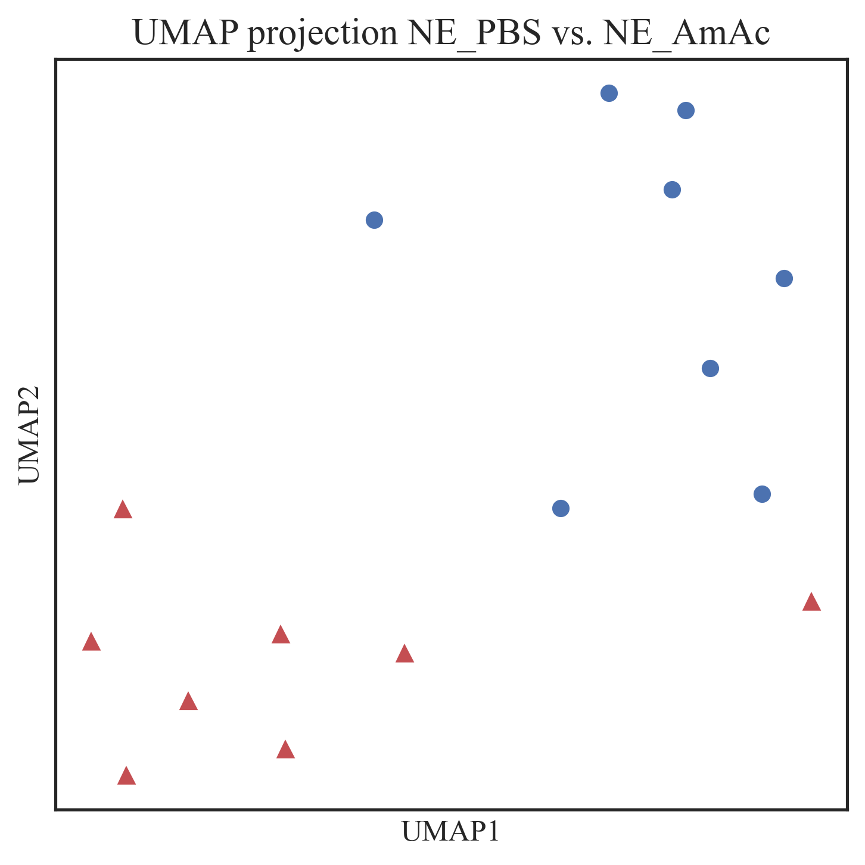
Relief-F (K=3)
Top 10 features
NE_PBS vs. AmAc
{'ENSMUSG00000104238': 'Gm37587',
'ENSMUSG00000103216': 'Gm37248',
'ENSMUSG00000116606': 'Gm10479',
'ENSMUSG00000026841': 'Fibcd1',
'ENSMUSG00000079965': 'Gm14853',
'ENSMUSG00000107136': 'Gm42466',
'ENSMUSG00000081492': 'Gm9311',
'ENSMUSG00000106536': 'Gm42508',
'ENSMUSG00000116678': 'Pgk1-ps1',
'ENSMUSG00000071551': 'Akr1c19'}

Slide 9
Multiomics Challenge
"We expect that the confidence interval will be tighter for the prediction using multiomics datasets as compared to individual transcriptomic, proteomic or metabolomic datasets“ – R01 Grant, AIM 2
We need:
a metric to evaluate standalone performance in a single modality
a metric to evaluate integrated multiomic performance

Slide 10
Relief-F
K = 3
N_features = 10

Slide 11
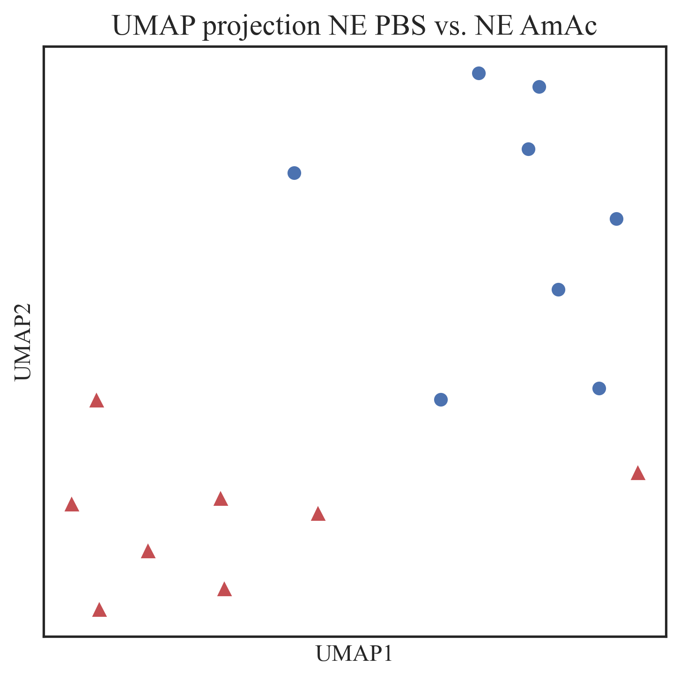
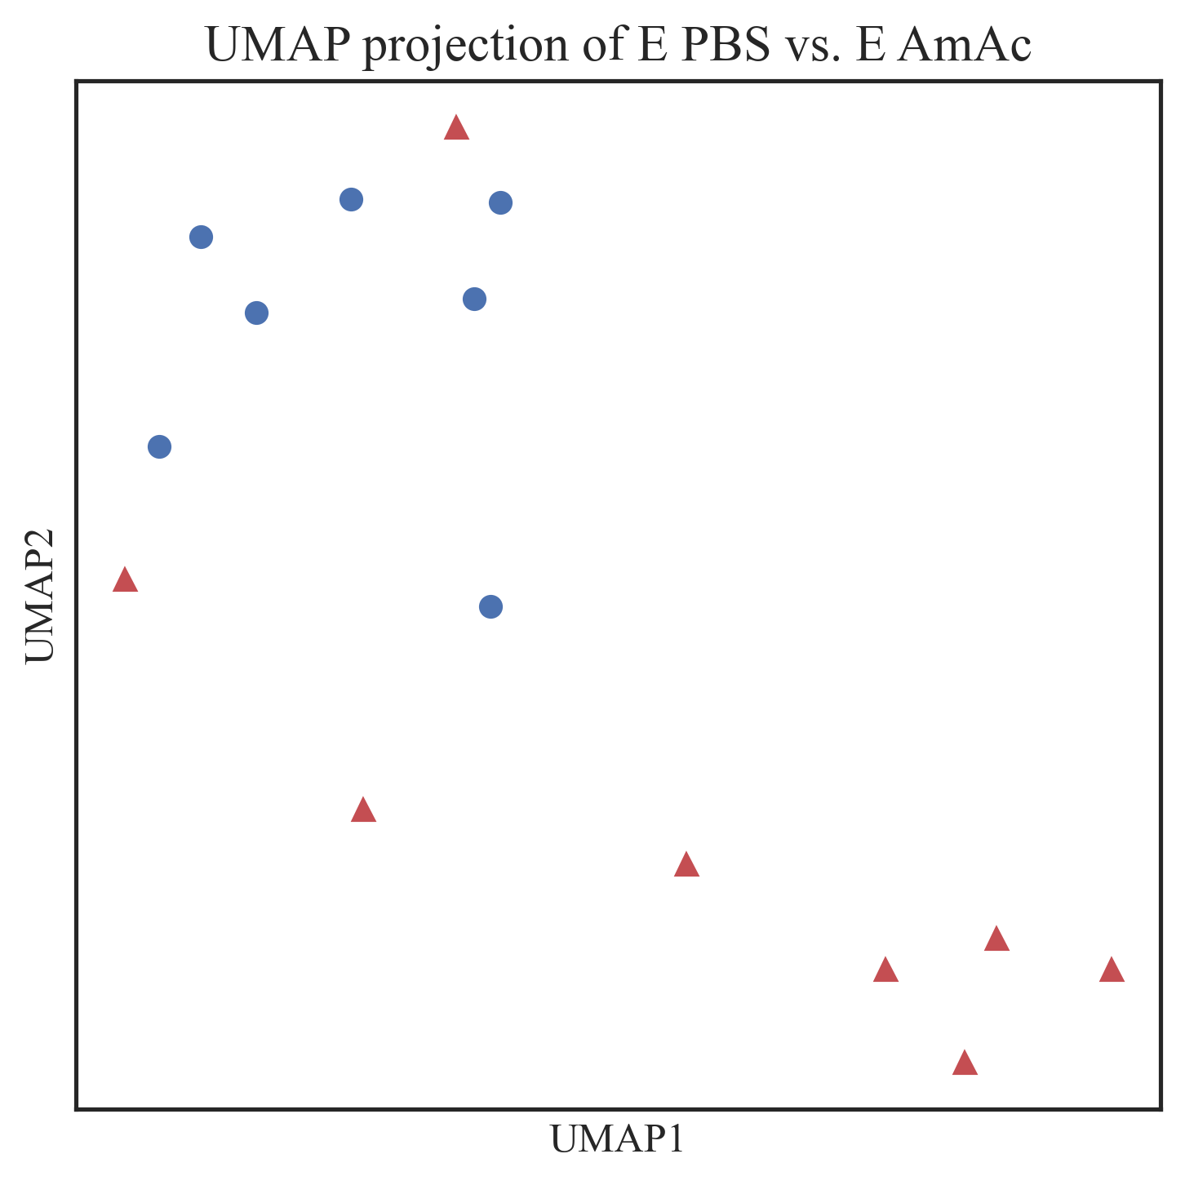
Relief-F (K=3)
Top 10 features
PBS vs. AmAc
ENSMUSG00000104238
ENSMUSG00000103216
ENSMUSG00000116606
ENSMUSG00000026841
ENSMUSG00000079965
ENSMUSG00000107136
ENSMUSG00000081492
ENSMUSG00000106536
ENSMUSG00000116678
ENSMUSG00000071551
ENSMUSG00000083692
ENSMUSG00000085787
ENSMUSG00000021384
ENSMUSG00000109337
ENSMUSG00000112530
ENSMUSG00000085984
ENSMUSG00000024268
ENSMUSG00000092097
ENSMUSG00000046952
ENSMUSG00000094530

Slide 12

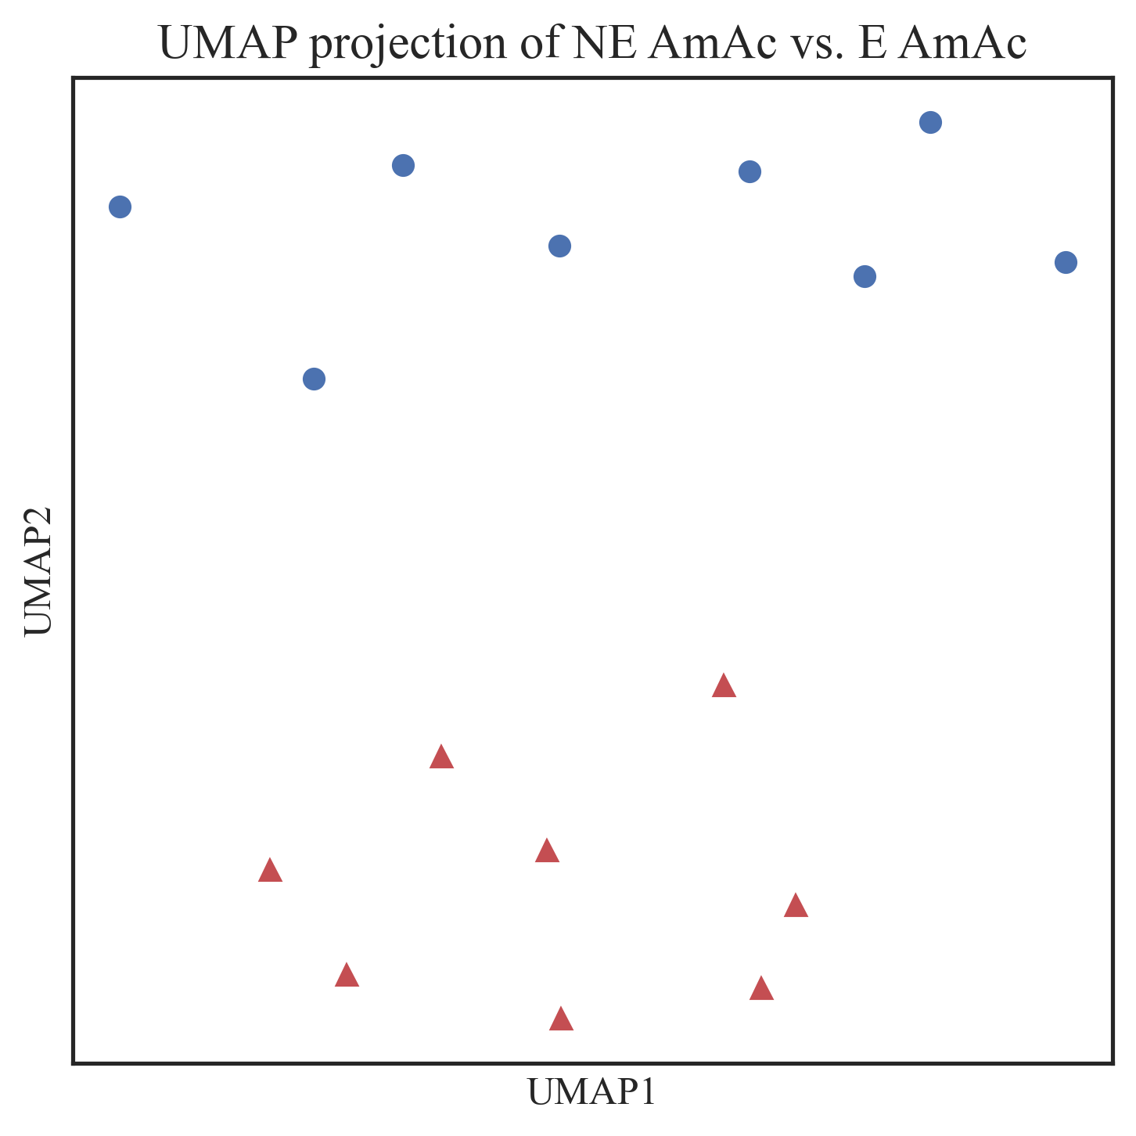
Relief-F (K=3)
Top 10 features
NE vs. E
ENSMUSG00000108957
ENSMUSG00000026579
ENSMUSG00000067201
ENSMUSG00000109539
ENSMUSG00000052724
ENSMUSG00000048304
ENSMUSG00000104585
ENSMUSG00000034579
ENSMUSG00000079711
ENSMUSG00000021384
ENSMUSG00000113427
ENSMUSG00000084050
ENSMUSG00000107535
ENSMUSG00000087312
ENSMUSG00000104066
ENSMUSG00000107538
ENSMUSG00000105224
ENSMUSG00000091636
ENSMUSG00000057223
ENSMUSG00000116647

Slide 13
Relief-F
K = 3
N_features = 20

Slide 14
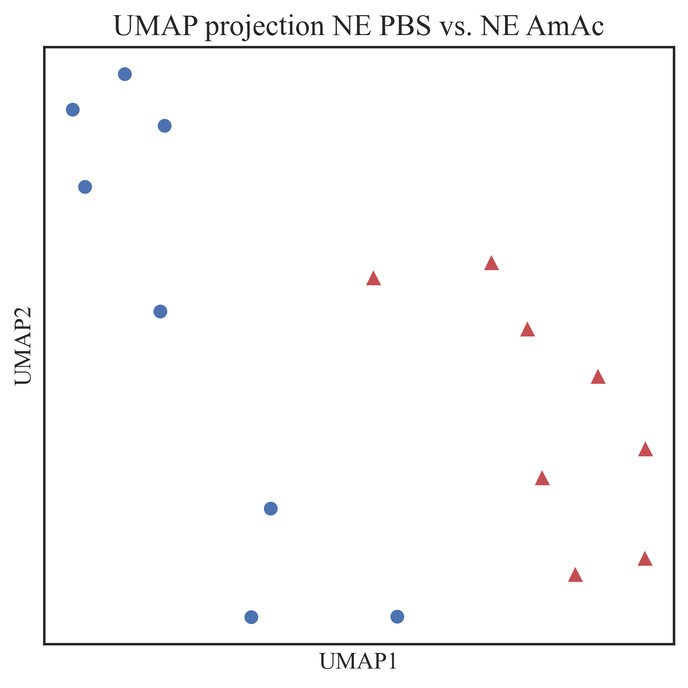
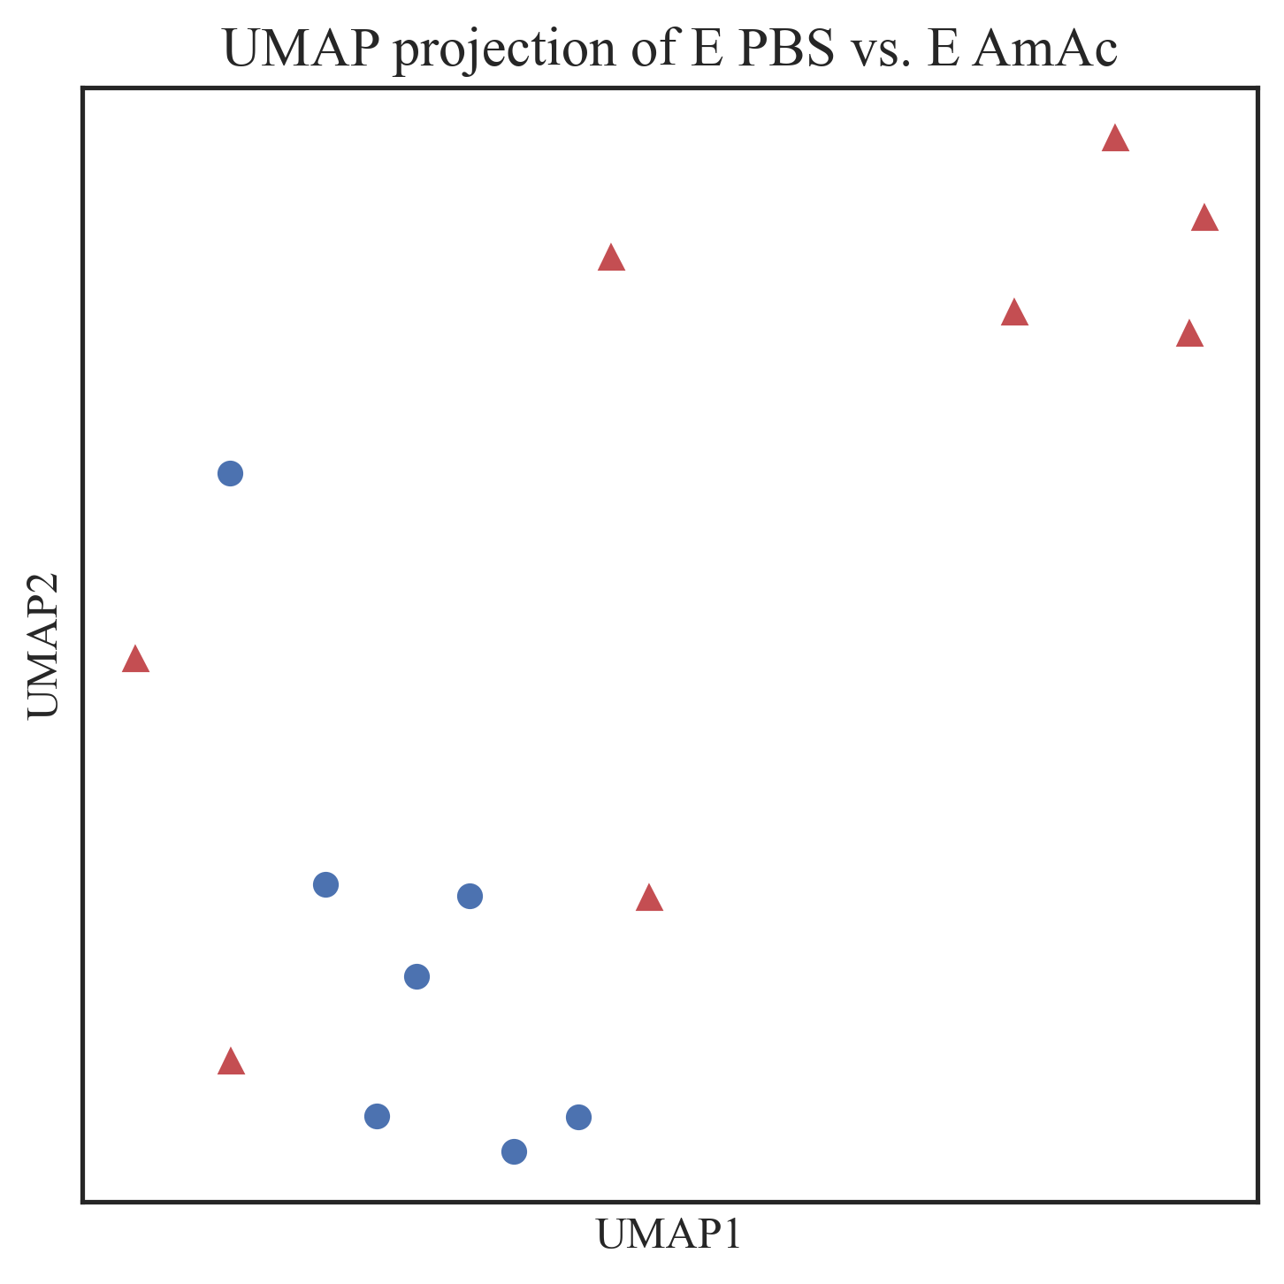
Relief-F (K=3)
Top 20 features
PBS vs. AmAc

Slide 15
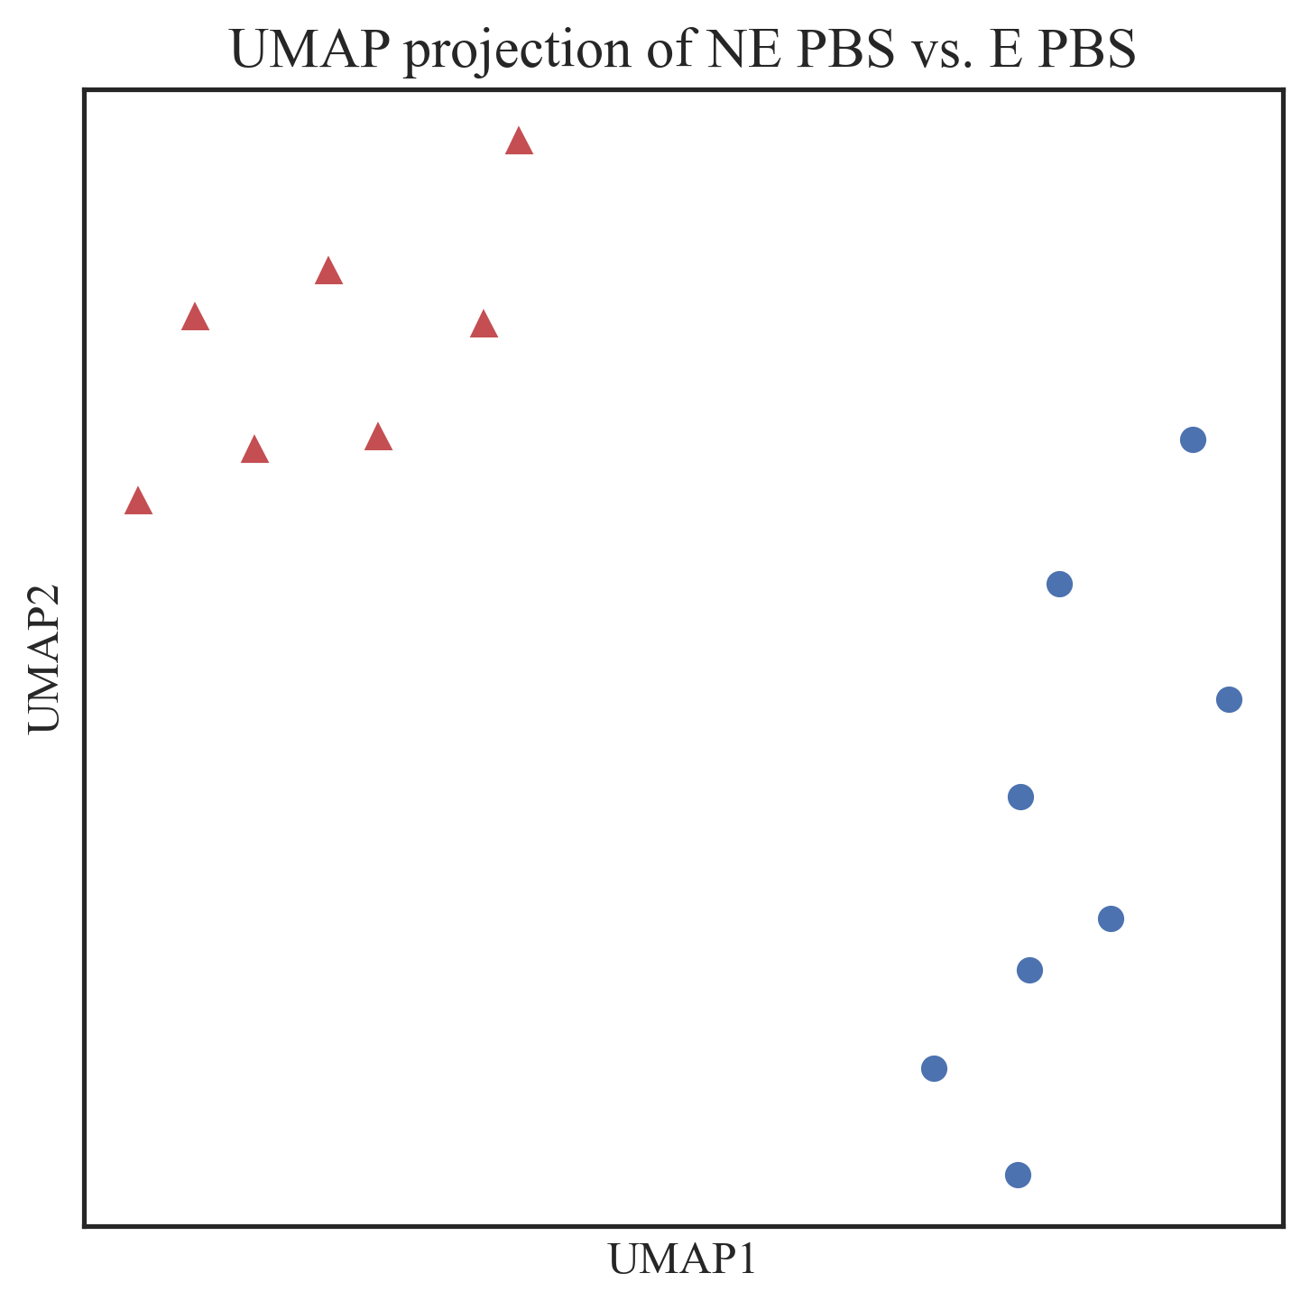
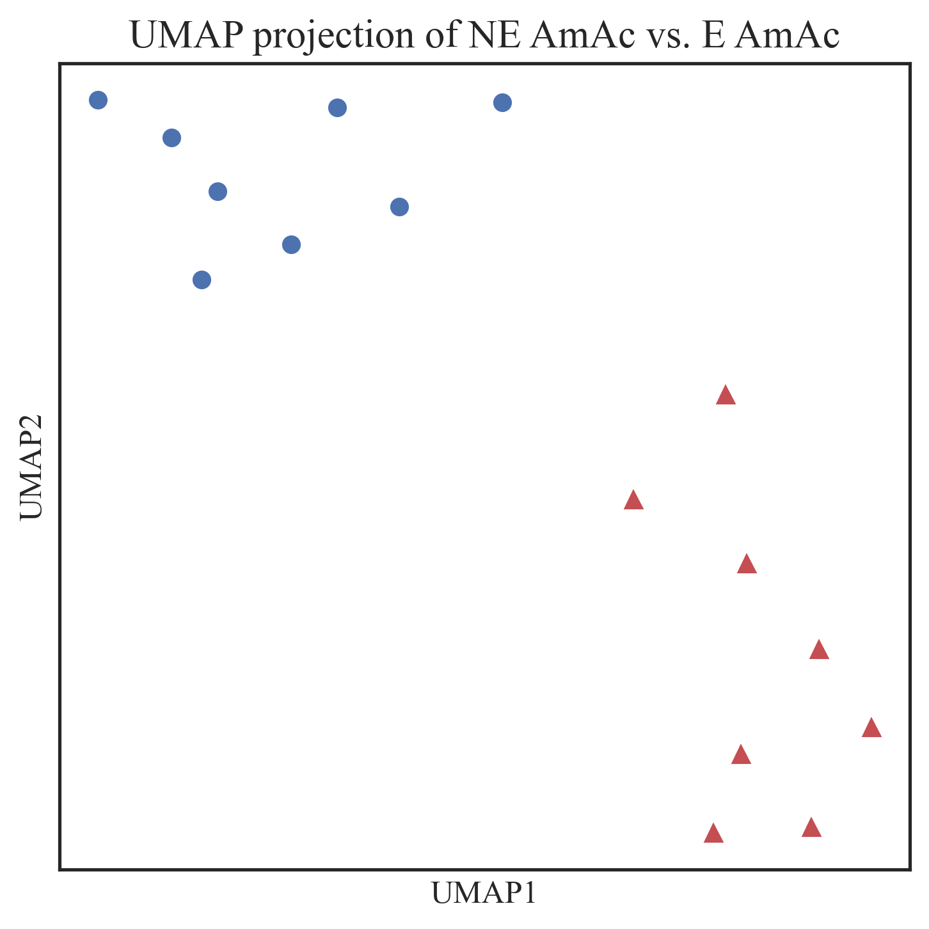
Relief-F (K=3)
Top 20 features
NE vs. E

Slide 16
Relief-F
K = 2
N_features = 10

Slide 17
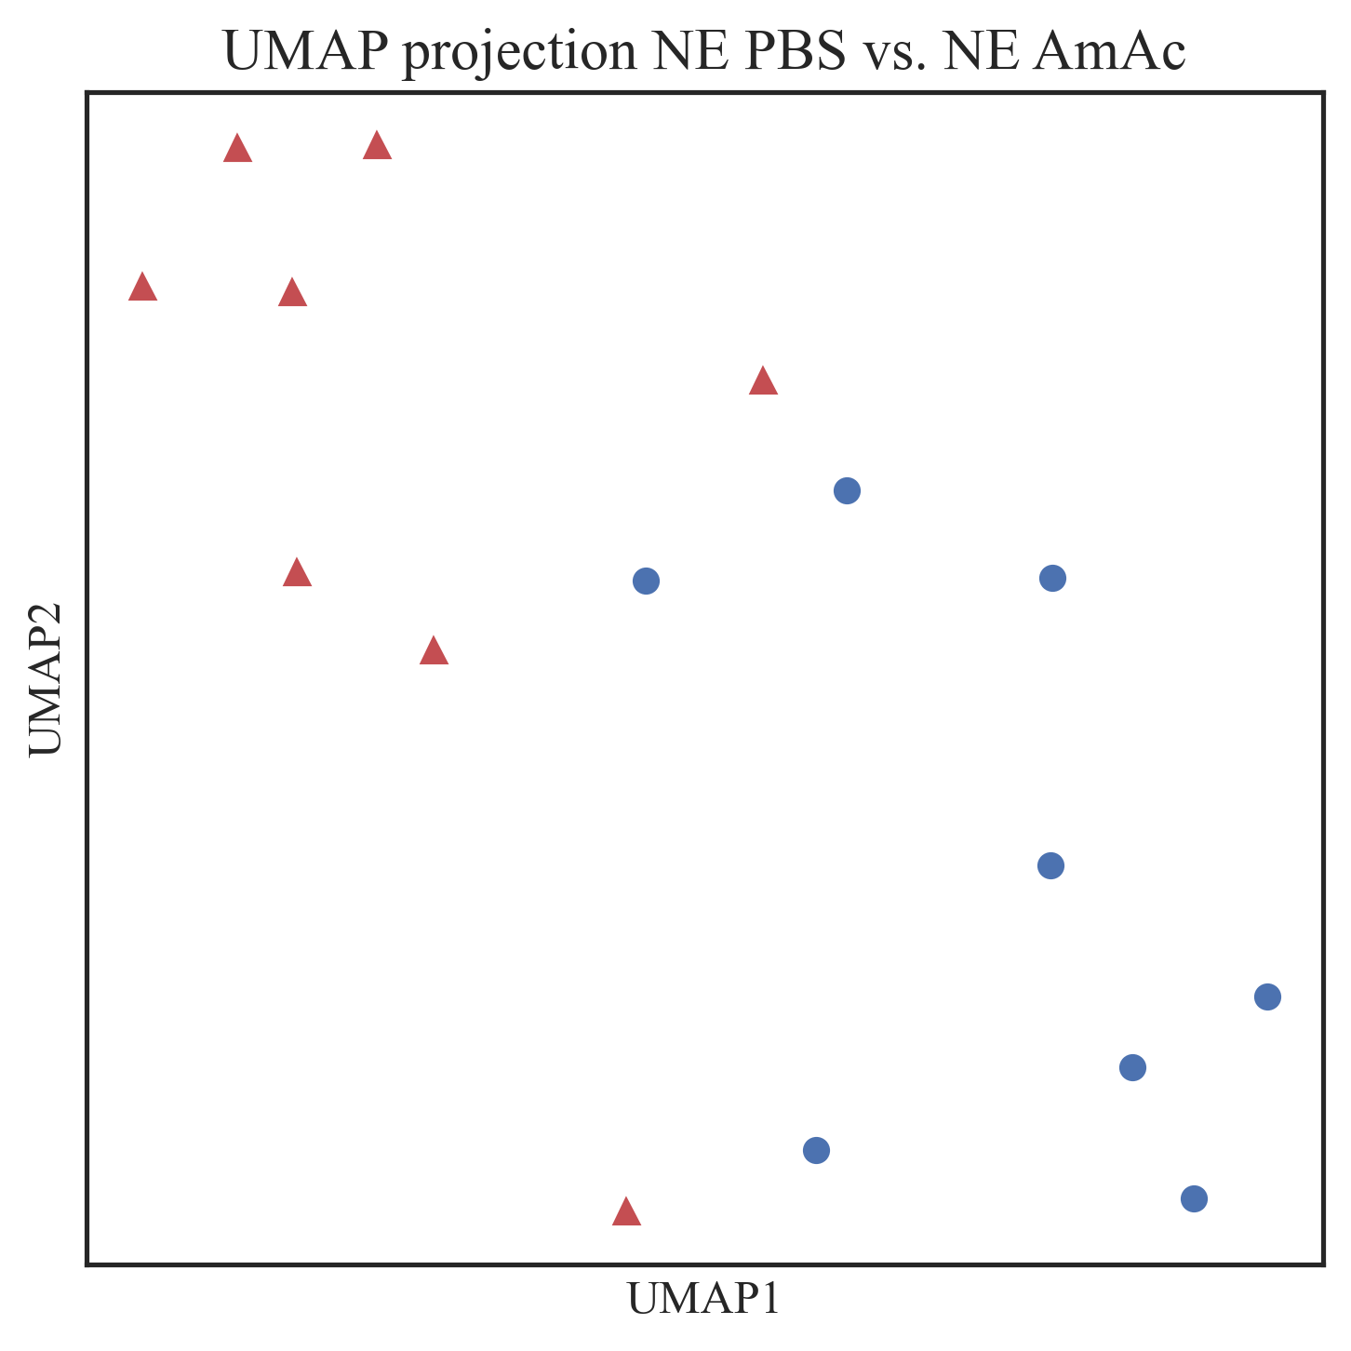
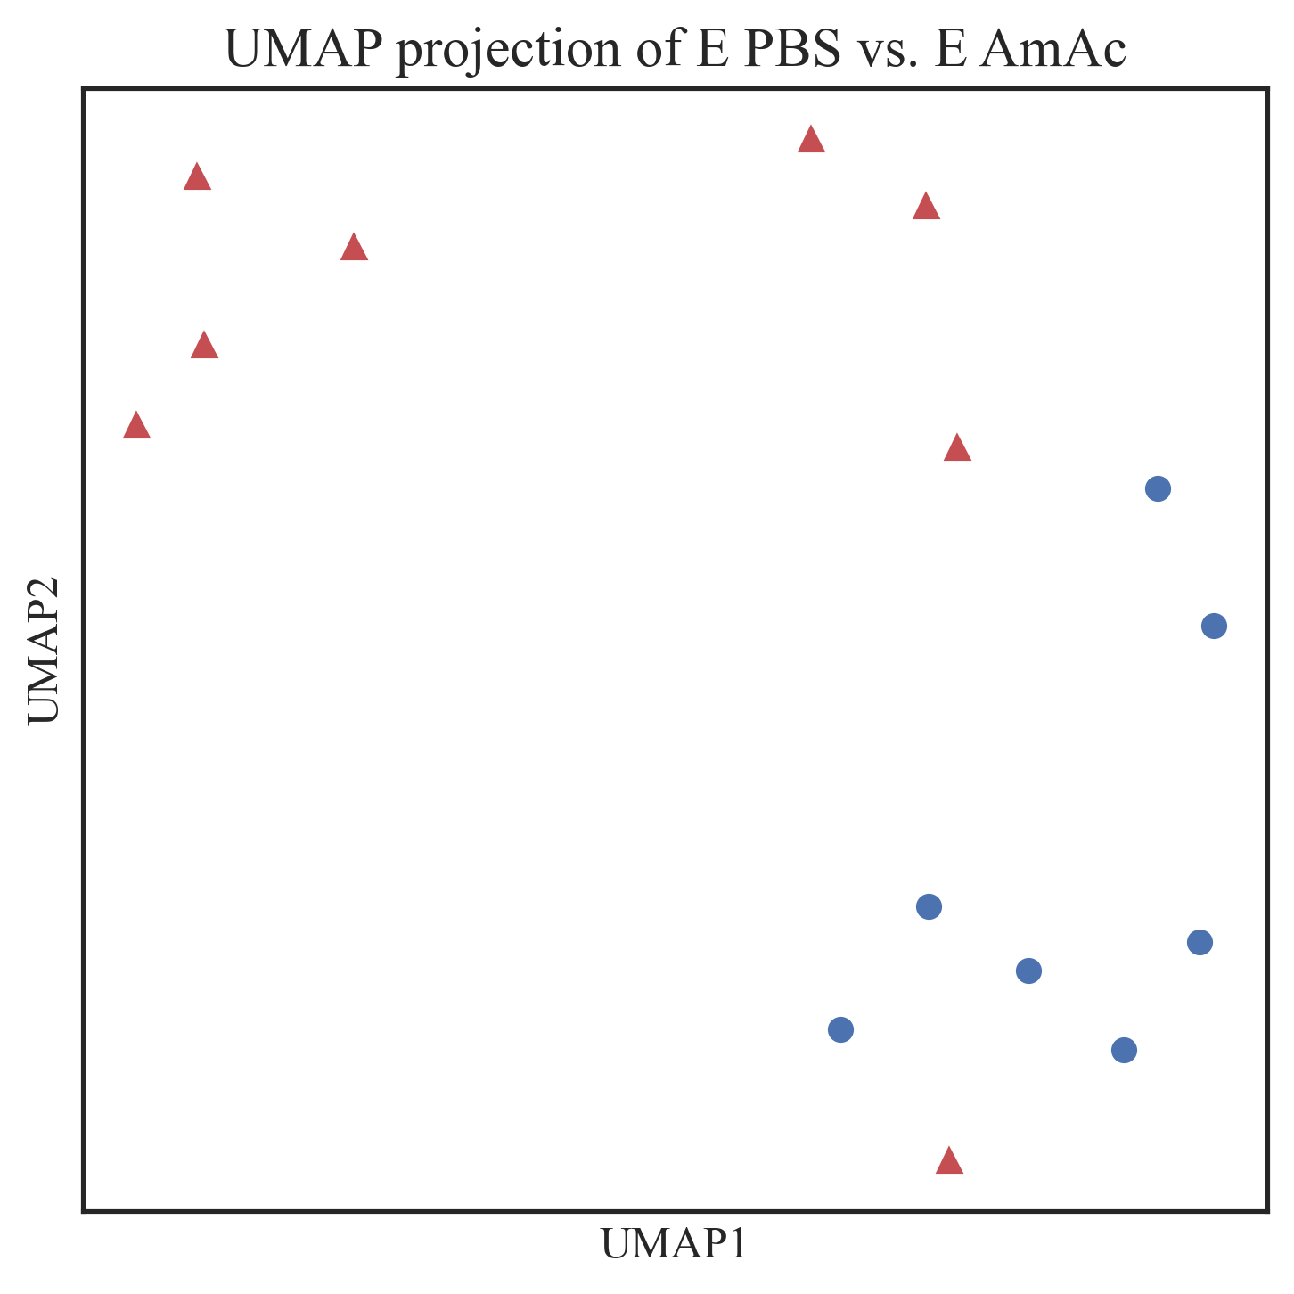
Relief-F (K=2)
Top 10 features
PBS vs. AmAc

Slide 18
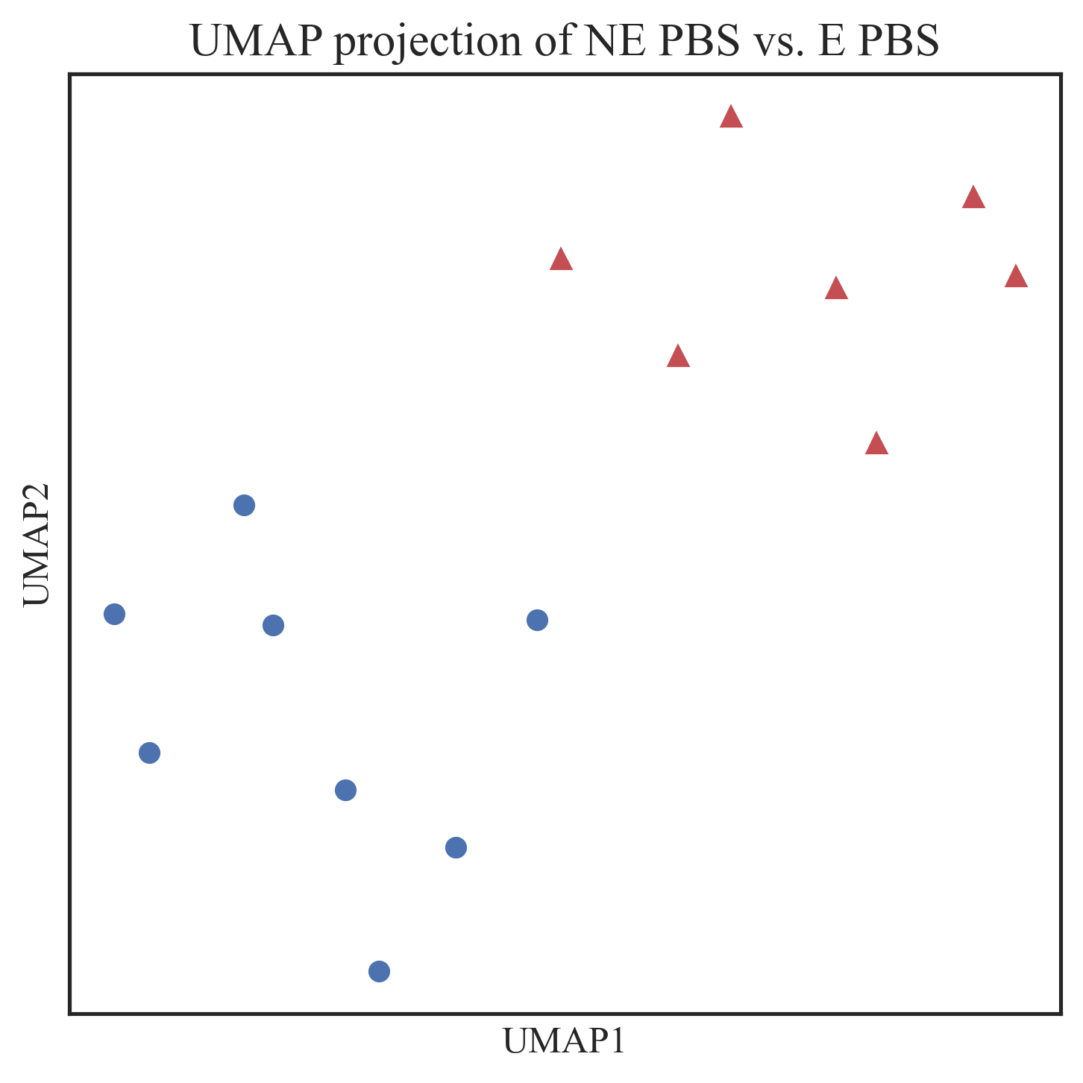
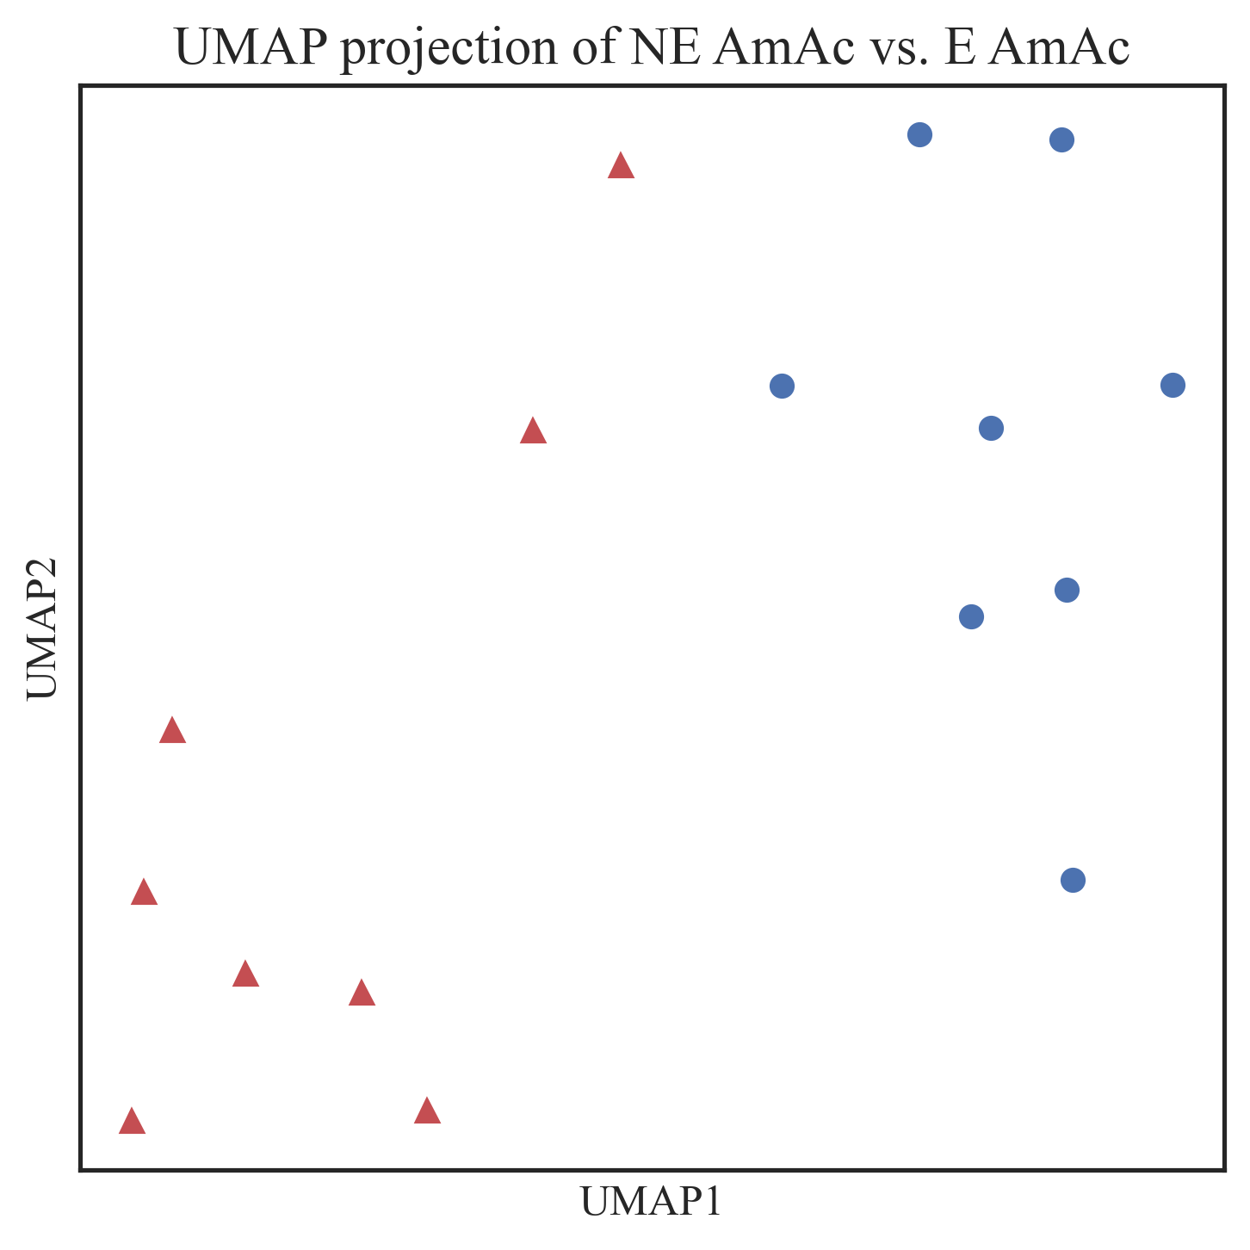
Relief-F (K=2)
Top 10 features
NE vs. E

Slide 19
Relief-F
K = 2
N_features = 20

Slide 20
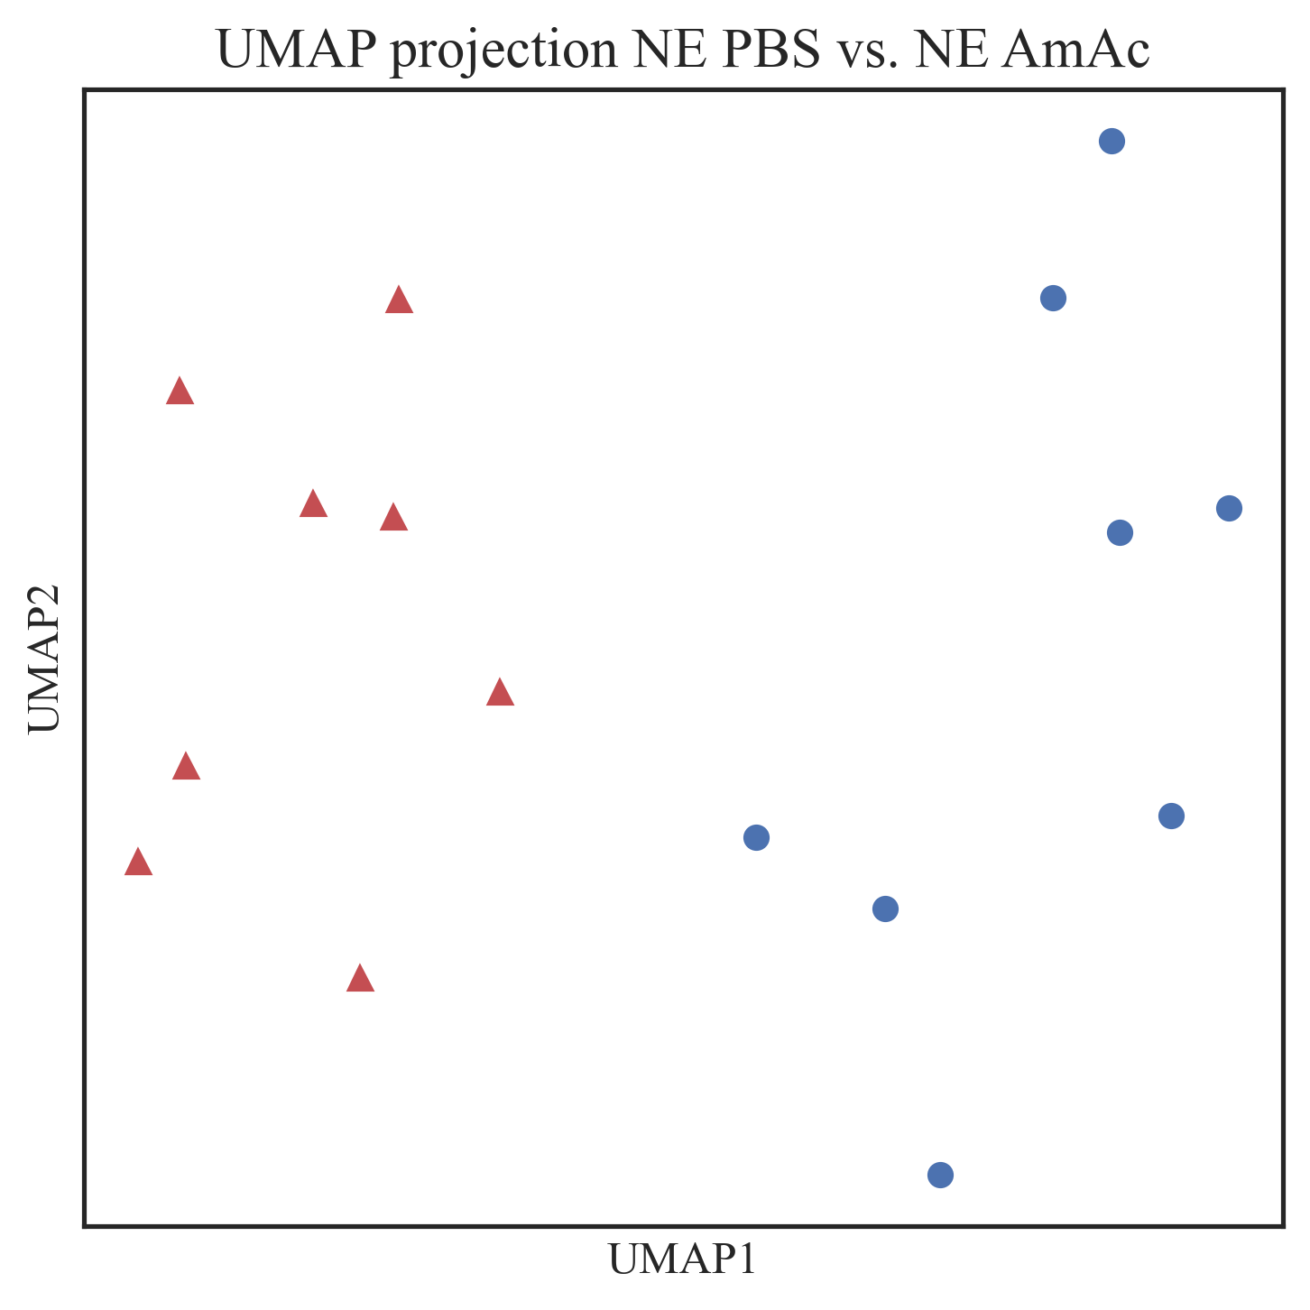
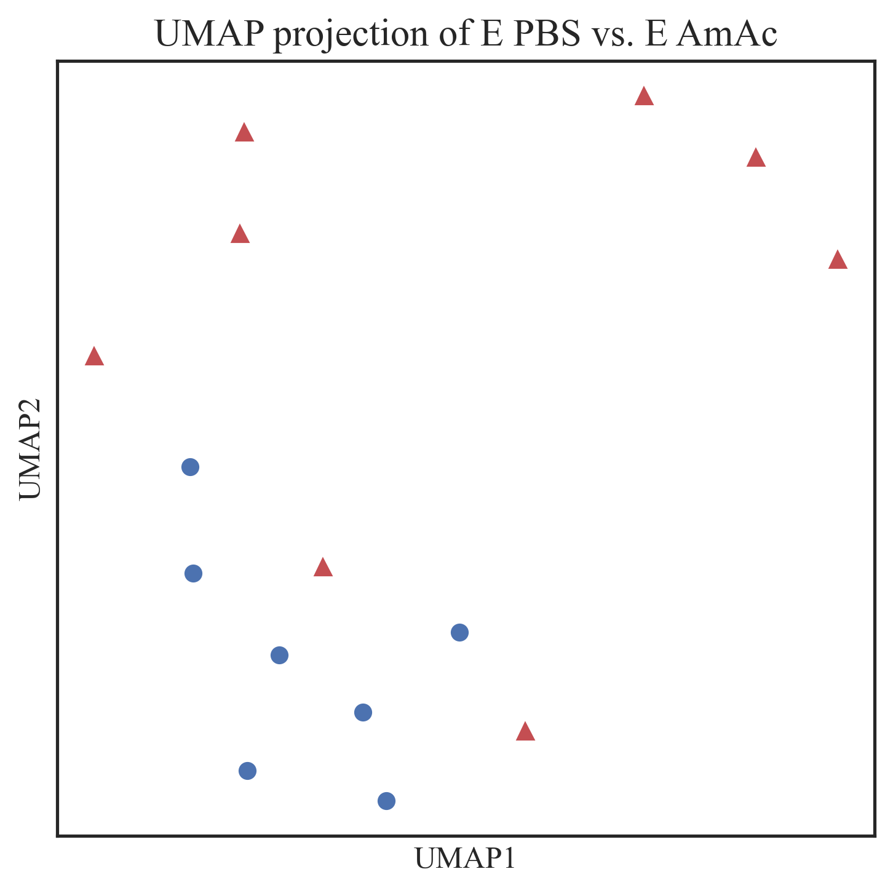
Relief-F (K=2)
Top 20 features
PBS vs. AmAc

Slide 21
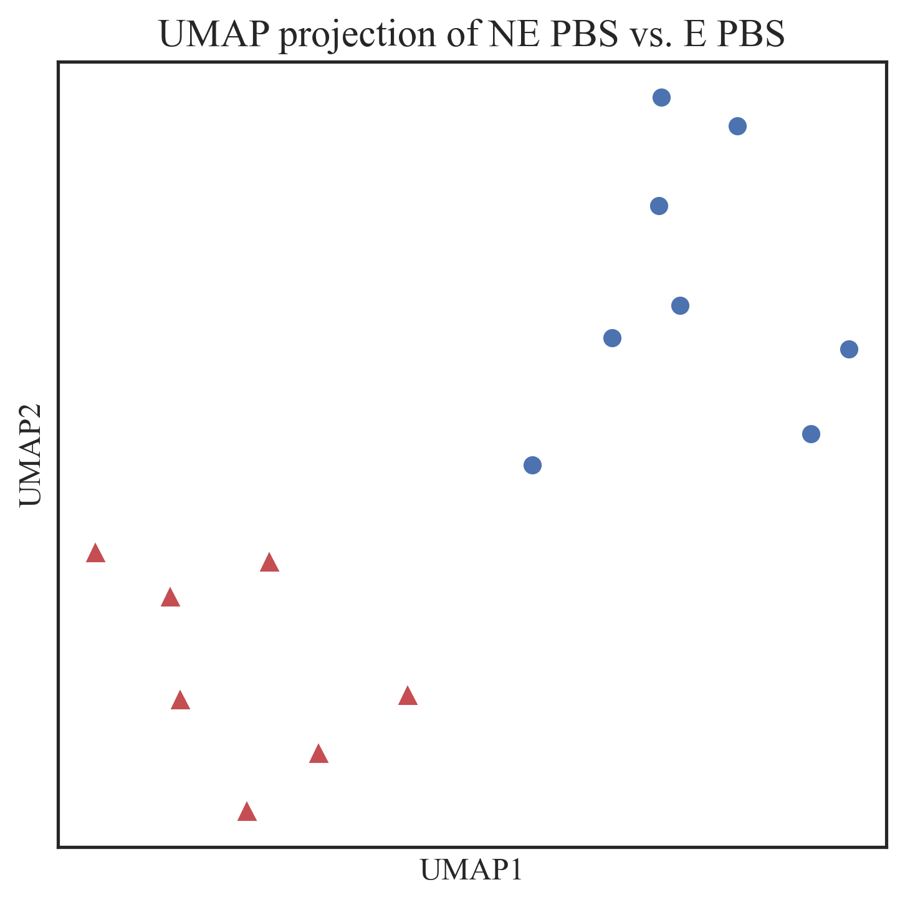
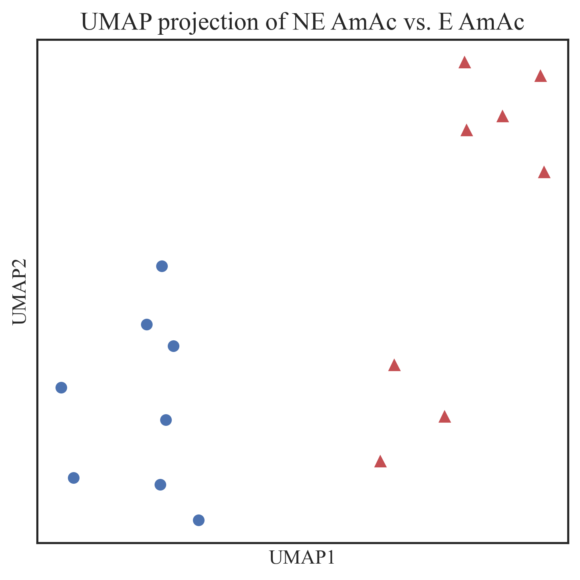
Relief-F (K=2)
Top 20 features
NE vs. E

